Slide 1
ODAQ: Audio rating analysis
Junwon & Fushing

Slide 2
MUSHRA (MUltiple Stimuli with Hidden Reference and Anchor) Test
Overview: MUSHRA is a listening test method used for evaluating perceived audio quality. MUSHRA was used to construct ODAQ: Open Dataset of Audio Quality (Torocoli et al.).
Test Setup:
Reference (100 Score): The original, highest-quality audio sample.
Anchor (0 Score): A deliberately degraded version (e.g. low-pass filtered) to establish a lower quality baseline
Test Samples: Various processed versions of the reference, including a hidden reference and hidden anchor.
Listener Task: Participants rate each sample on a 0-100 scale, aiming to correctly identify the reference and anchor.
Purpose:
Ensures consistent and reliable quality assessment.
Helps mitigate individual bias by anchoring evaluations. → Not perfect, and addressed in this study
Provides a standardized benchmark for comparing different listeners & audio processing methods.
→ Not comparable with those who are not informed of anchor and reference presence, and addressed in this study

Slide 3
Dataset Overview
Examining given dataset from the experiment.

Slide 4
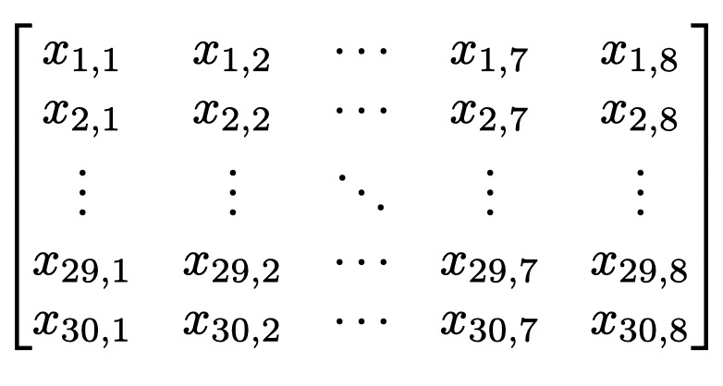
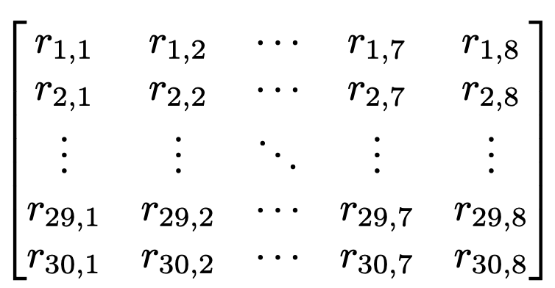
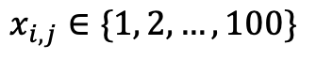
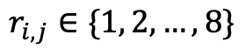
Data Structure: Individual’s Scores
42 Participants (score matrices):
Experts (1-26)
Cohort 1 Students (27-34)
Cohort 2 Students (35-42)
30 Audio Samples (8 quality levels per sample):
2 low-pass anchors
5 processed samples
1 reference (untouched)
Score Matrix
Ranking Matrix
LP3.5
LP7
Q1 – Q4
Q5
Ref
Ranking Algorithm (Dense,
K-Means)
30 Audio
Samples
8 Quality Levels
$$x_{i,j}∈\{1, 2, …, 100\}$$
$$r_{i,j}∈\{1, 2, …, 8\}$$

Slide 5
Visualizing listeners’ scoring patterns
Are there visual differences in individual’s scoring patterns?

Slide 6
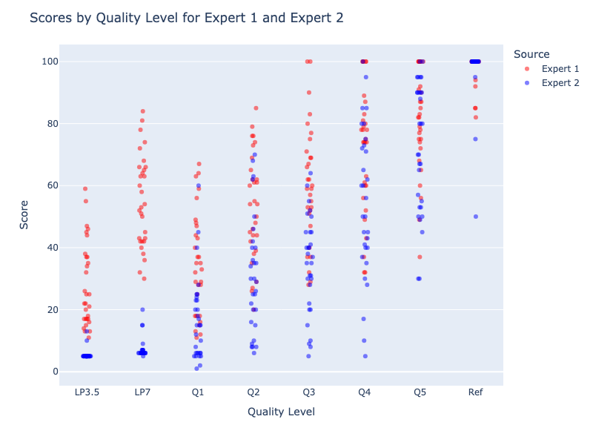
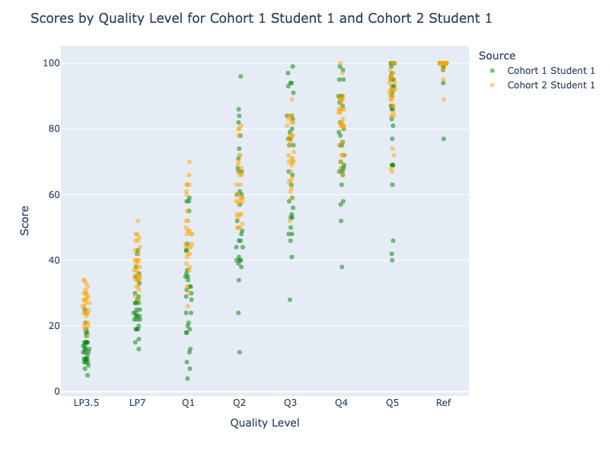
Strip Plot : Expert Scores, Student Scores by Quality Level
Notes:
It is evident to see the differences between the two experts and two students, respectively. The expert 1 is too generous to give high scores, while the expert 2 is the opposite. In fact, expert 2 is not very much an expert at all. The student from Cohort-2 seems to be very precise than the student from Cohort-1.

Slide 7
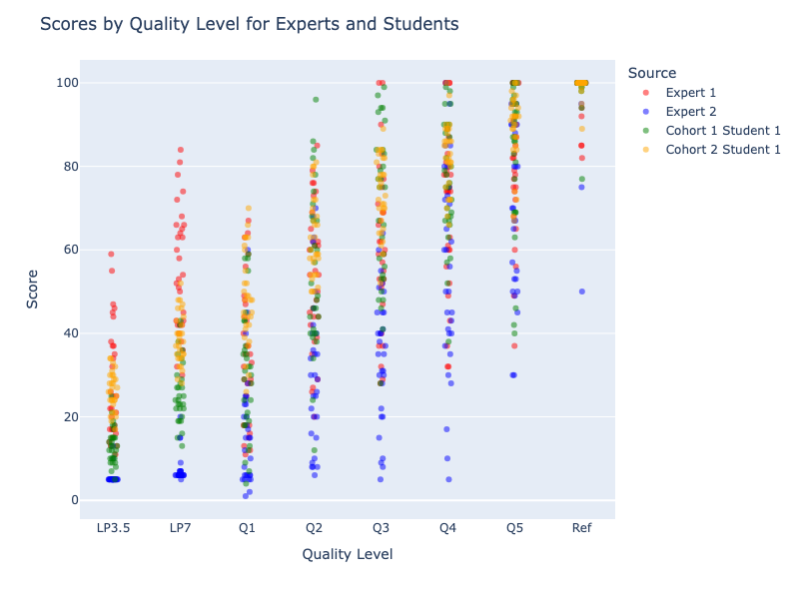
Strip Plot: Expert & Student Scores by Quality Level
Notes:
When we pool these four individuals together, we see that these two students are well-better than the two experts.

Slide 8
Ranking Algorithms
Differences resulting from dense ranking and k-means ranking methods.

Slide 9
Competition Ranking
K-Means Ranking
Assigns ranks based on sorted scores
Ties receive the same rank, and next rank is skipped accordingly
Example: If two scores tie for 2nd, the next rank assigned is 4th.
Groups scores into k=8 clusters using K-Means
Ranks clusters based on mean score
Scores in the same cluster receive the same rank
Best for clear score-based rankings
Useful when scores are not evenly distributed
Precise, direct interpretation
Meaningful groups

Slide 10
Visualizing Competition Ranking

Slide 11
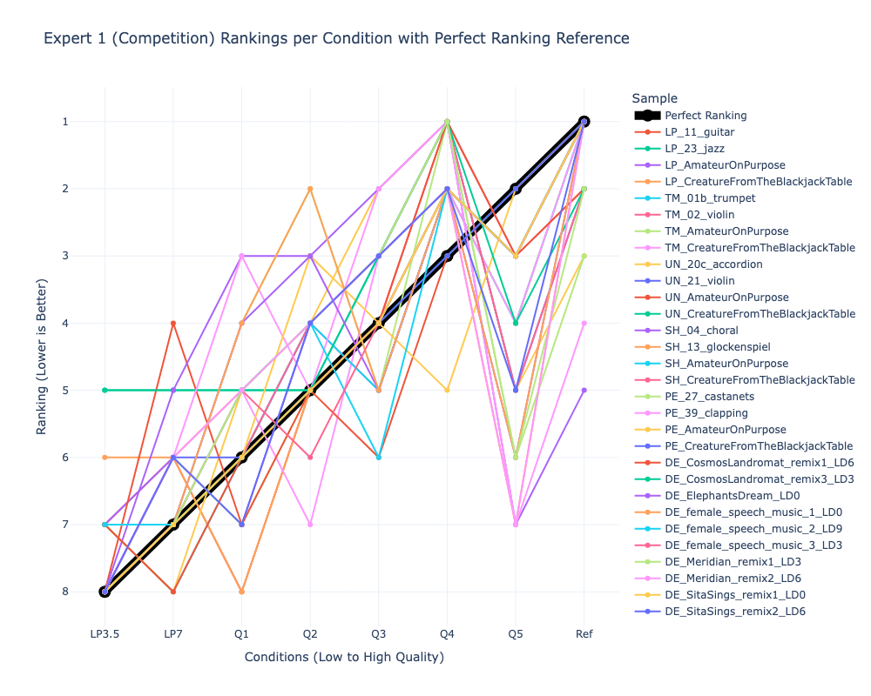
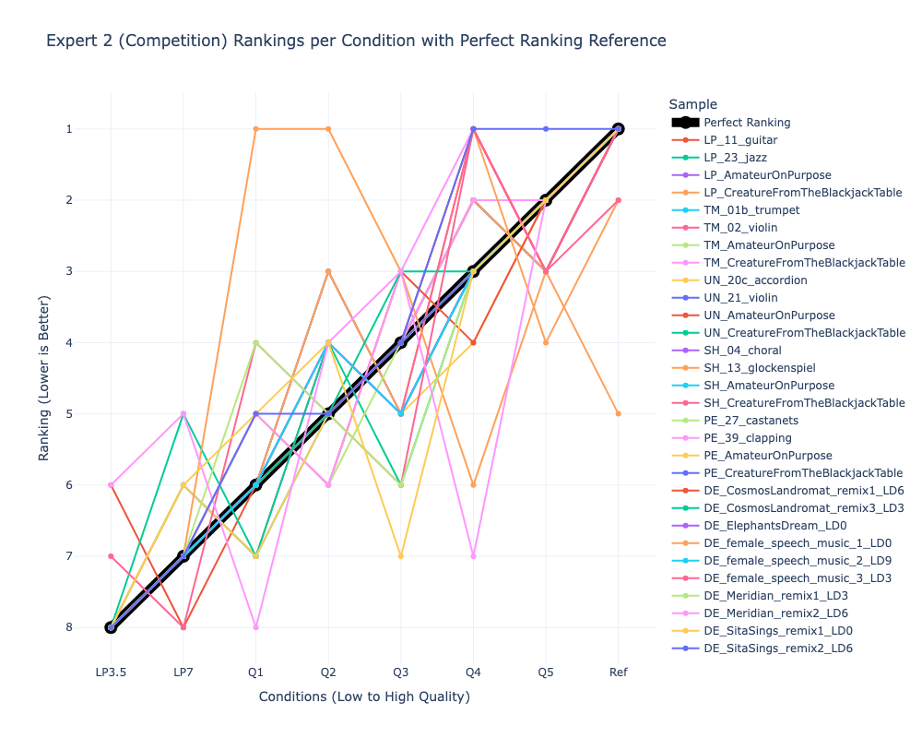
Spaghetti Plot: Expert (Competition) Rankings by Audio Sample
Notes:
When we pool these four individuals together, we see that these two students are well-better than the two experts.

Slide 12
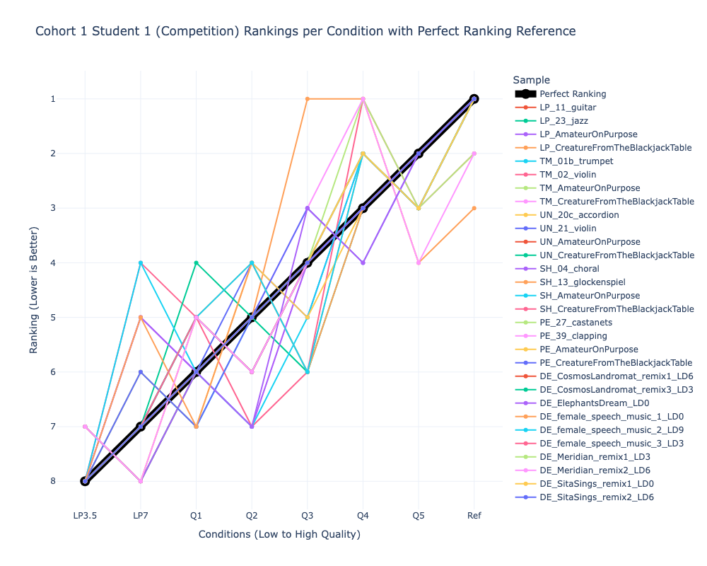
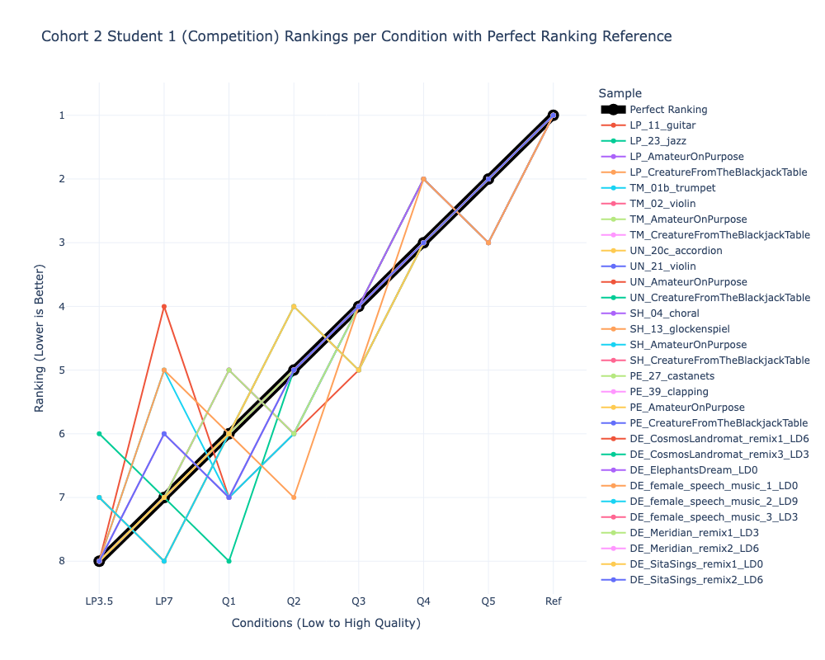
Spaghetti Plot: Student (Competition) Rankings by Audio Sample
Notes:
When we pool these four individuals together, we see that these two students are well-better than the two experts.

Slide 13
Visualizing K-Means Ranking

Slide 14
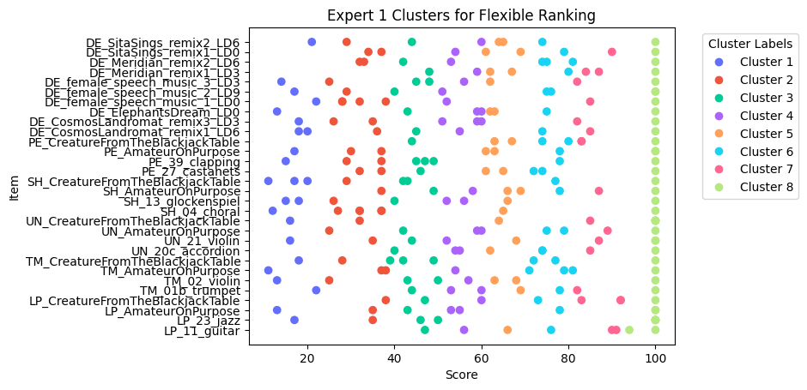
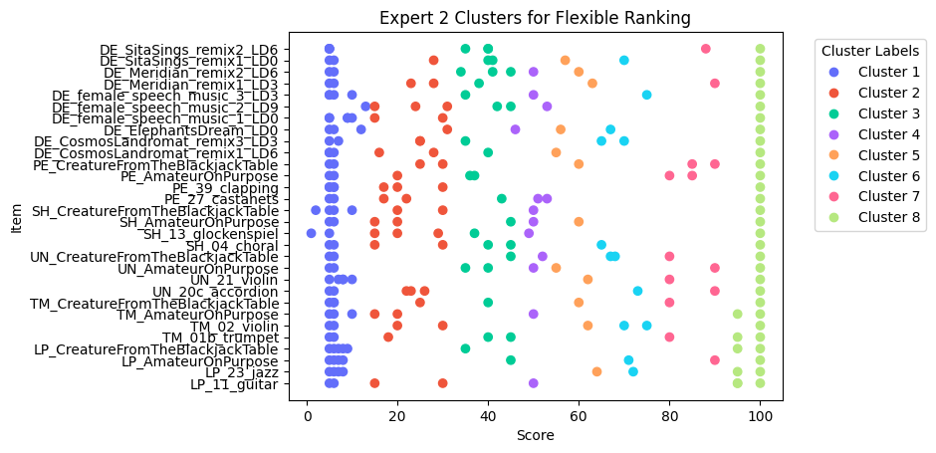
K-Means Results: Expert Rankings by Audio Sample

Slide 15
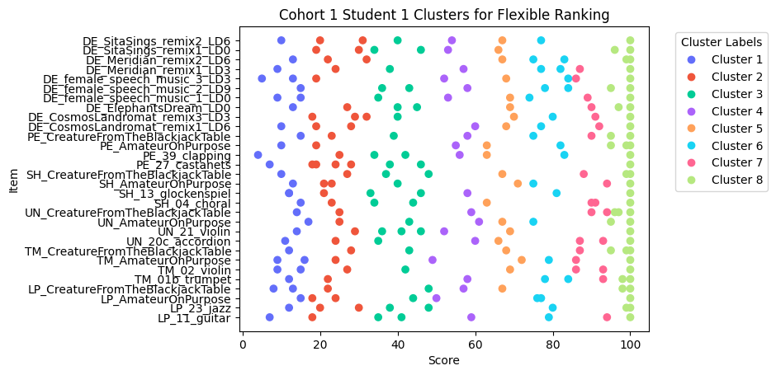
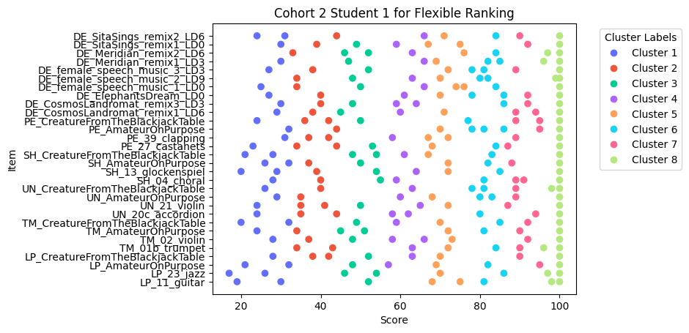
K-Means Results: Student Rankings by Audio Sample

Slide 16
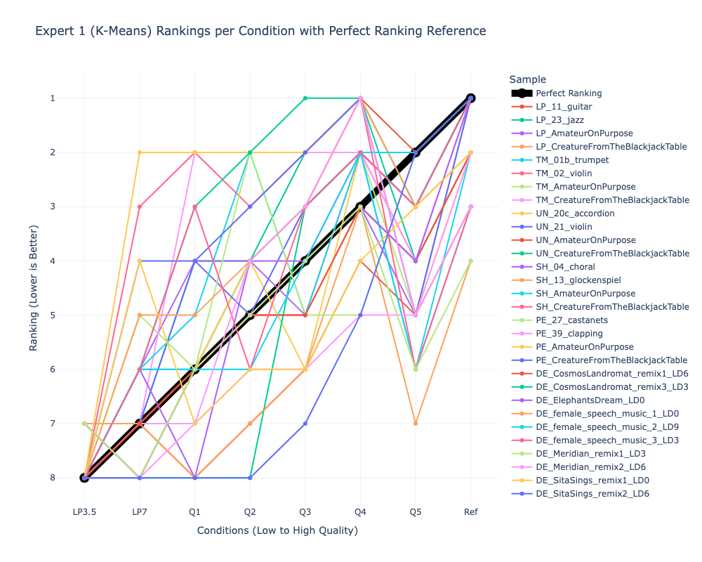
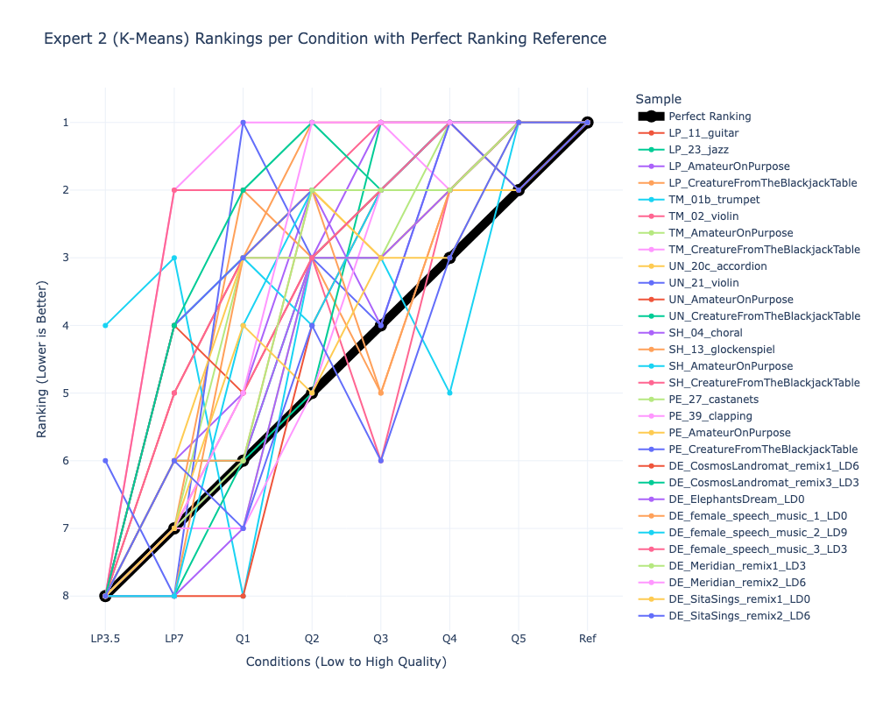
Spaghetti Plot: Expert (K-Means) Rankings by Audio Sample
Notes:
When we pool these four individuals together, we see that these two students are well-better than the two experts.

Slide 17
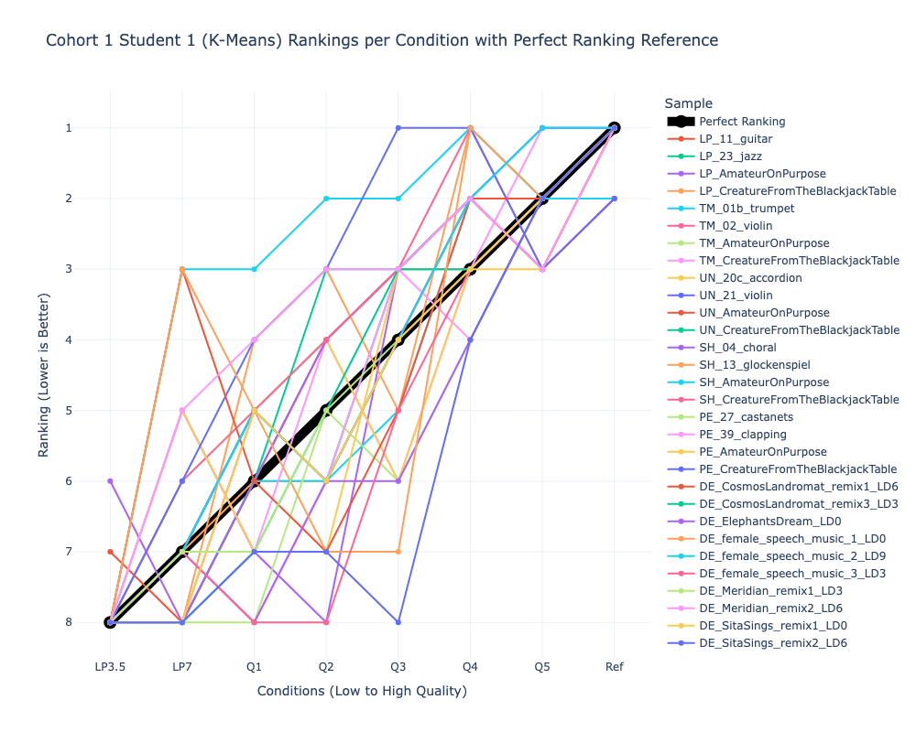
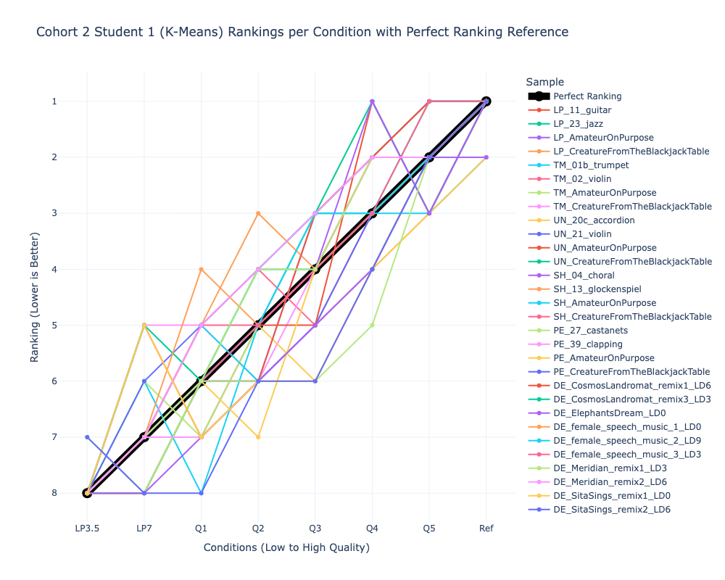
Spaghetti Plot: Student (K-Means) Rankings by Audio Sample
Notes:
When we pool these four individuals together, we see that these two students are well-better than the two experts.

Slide 18
Dataset Restructuring
Utilize ranked data to create distance matrices for comparison across audio samples and listeners.

Slide 19
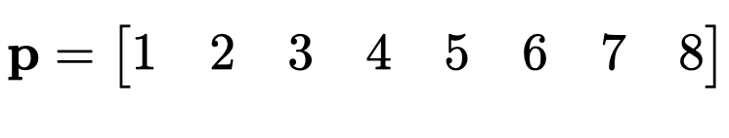
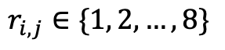
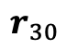
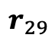

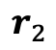
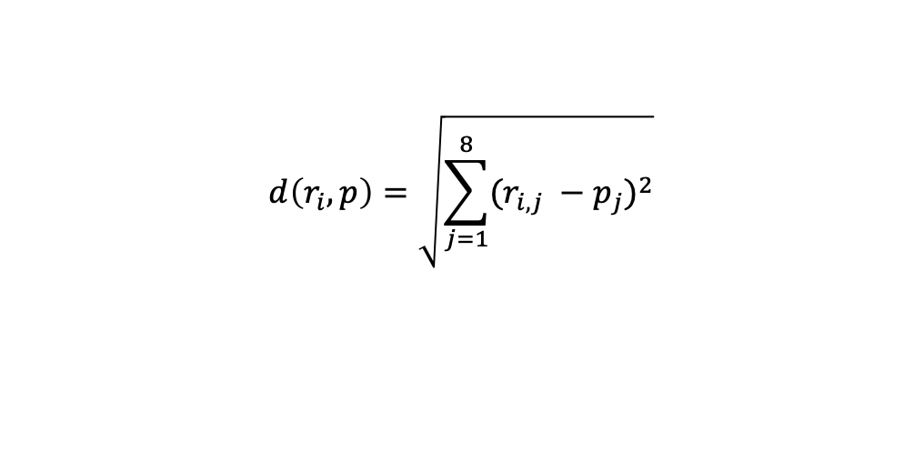
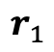
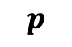
Individual’s Rankings vs. Perfect Rankings
Ranking Matrix
Perfect Ranking Vector
$$r_{1}$$
$$r_{2}$$
30 Audio
Samples
$$p$$
$$⋮$$
$$r_{29}$$
$$r_{30}$$
8 Quality Levels
$$r_{i,j}∈\{1, 2, …, 8\}$$
$$d\left(r_{i}, p\right)=\sqrt{\sum_{j=1}^{8}{{(r_{i,j} −p_{j})}^{2}}}$$
Compute Euclidean distance:

Slide 20
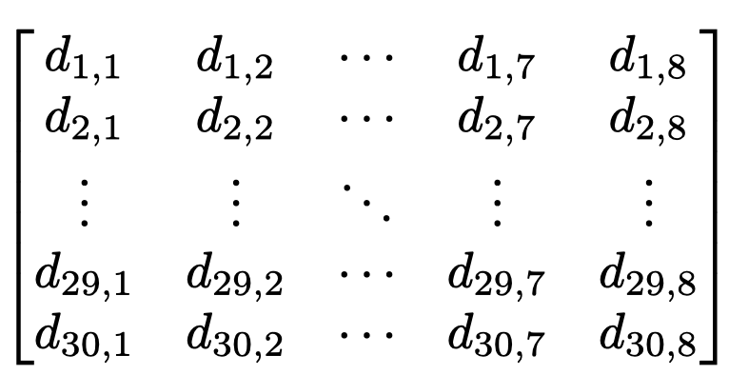
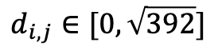
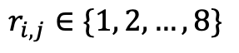
Individual’s Distance Matrix
Ranking Matrix
Distance Matrix
30 Audio
Samples
8 Quality Levels
$$r_{i,j}∈\{1, 2, …, 8\}$$
$$d_{i,j}∈[0, \sqrt{392}]$$

Slide 21
Heatmaps & Hierarchical Clustering
First steps to identify similar groups of audio samples and listeners.

Slide 22
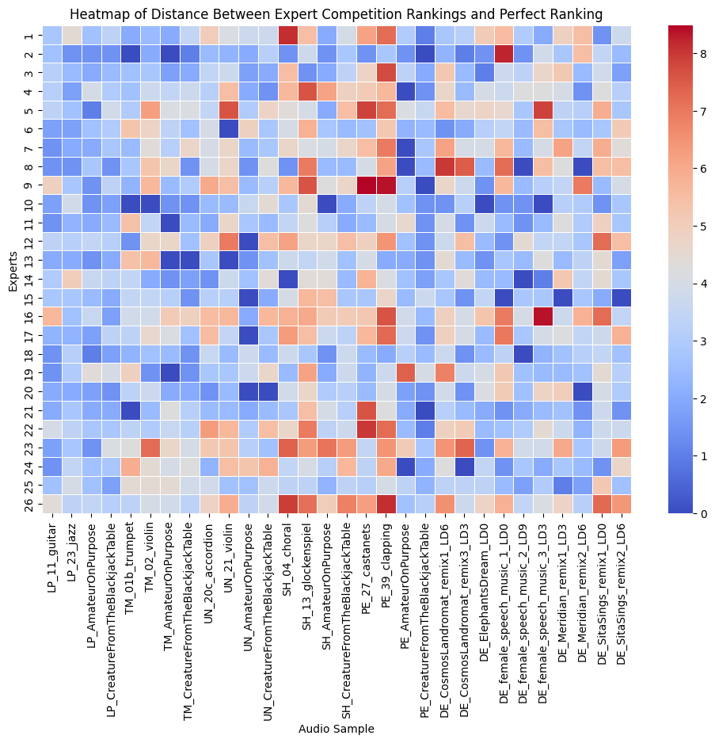
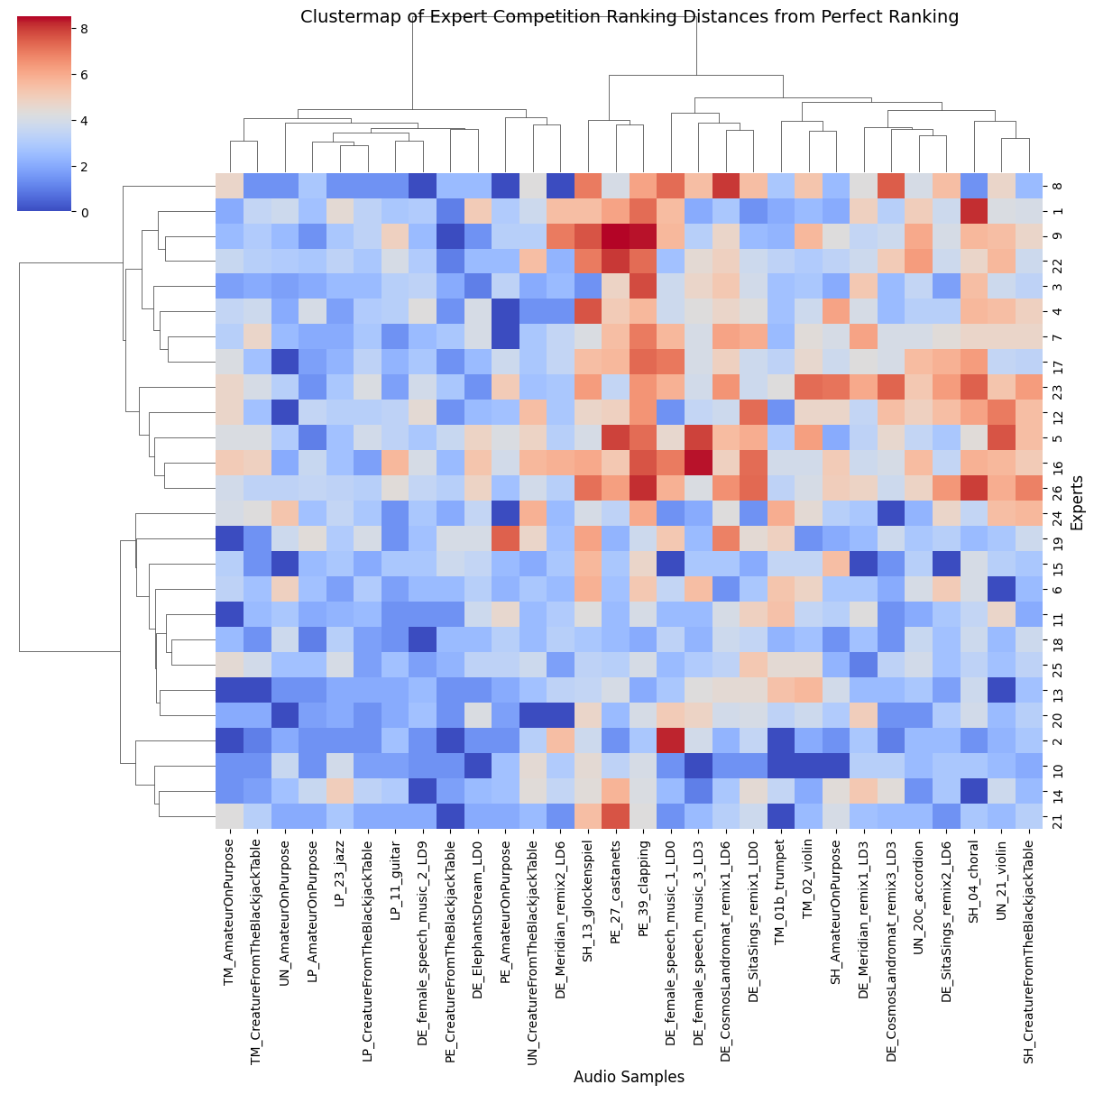
Visualizing Groups (Competition Ranking): Experts & Audio Samples

Slide 23
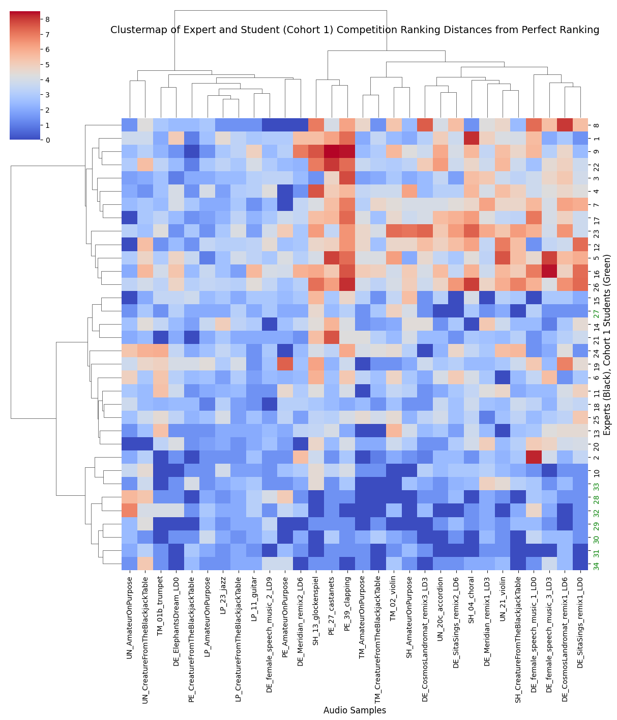
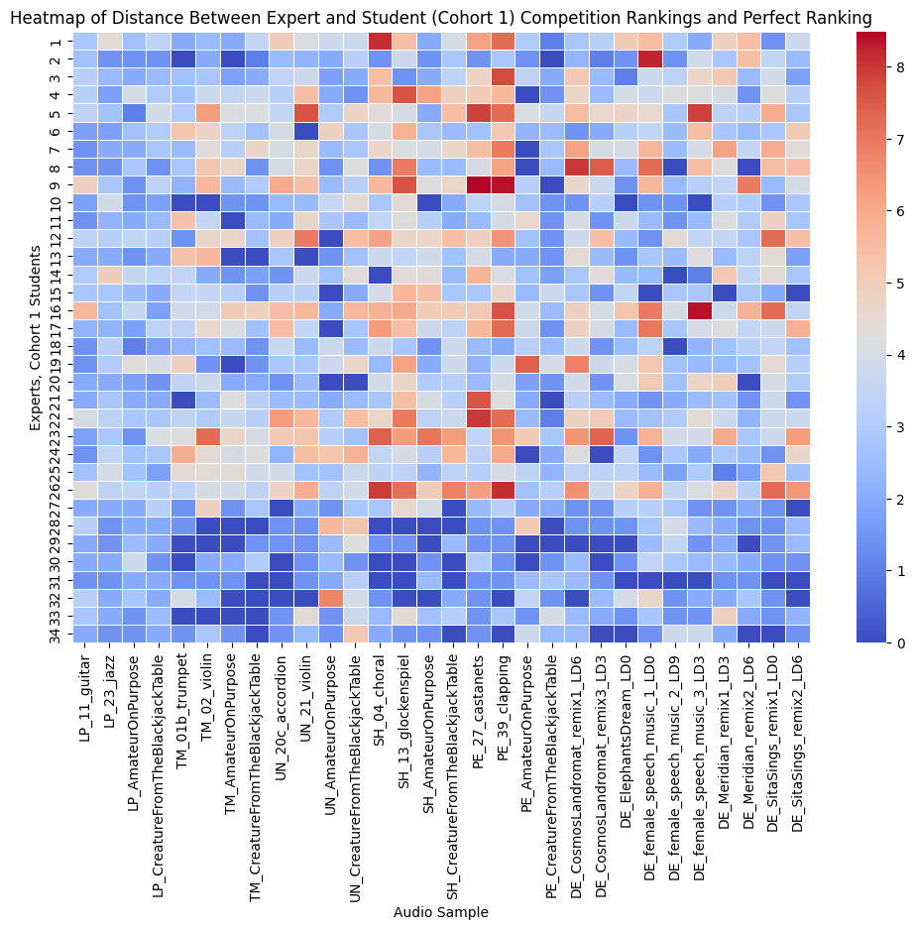
Visualizing Groups (Competition Ranking): Experts, Cohort 1 Students & Audio Samples

Slide 24
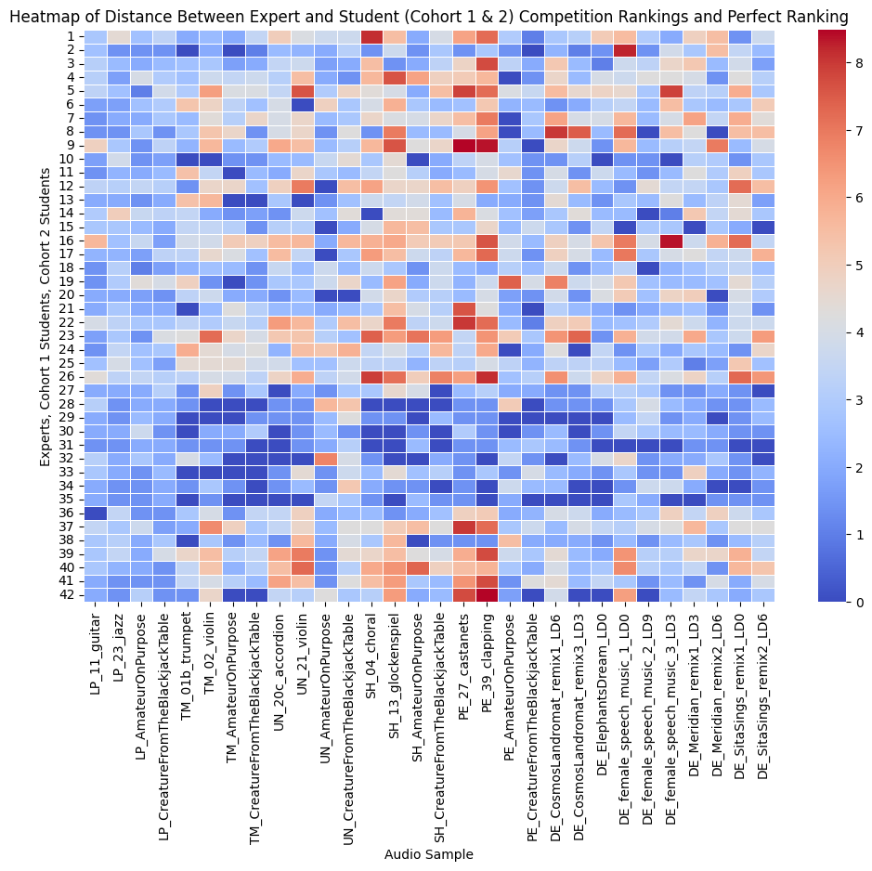
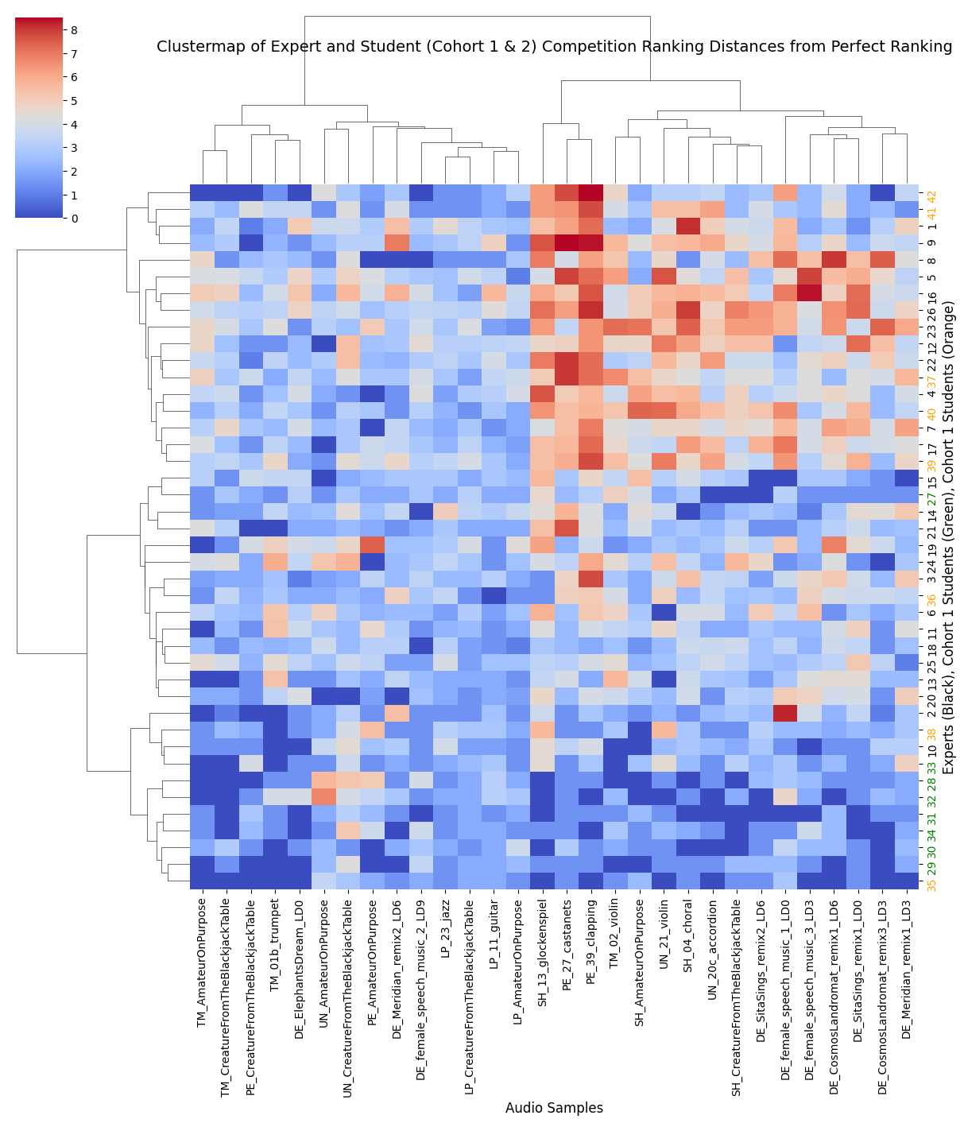
Visualizing Groups (Competition Ranking): Experts, Cohort 1 Students, Cohort 2 Students & Audio Samples

Slide 25
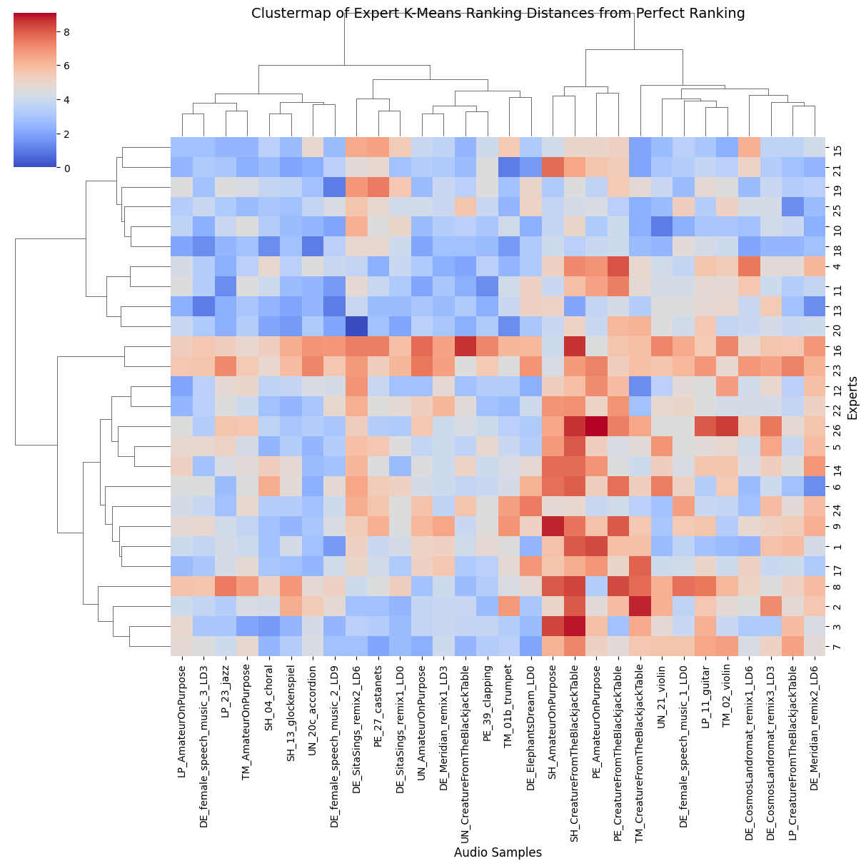
Visualizing Groups (K-Means Ranking): Experts & Audio Samples

Slide 26
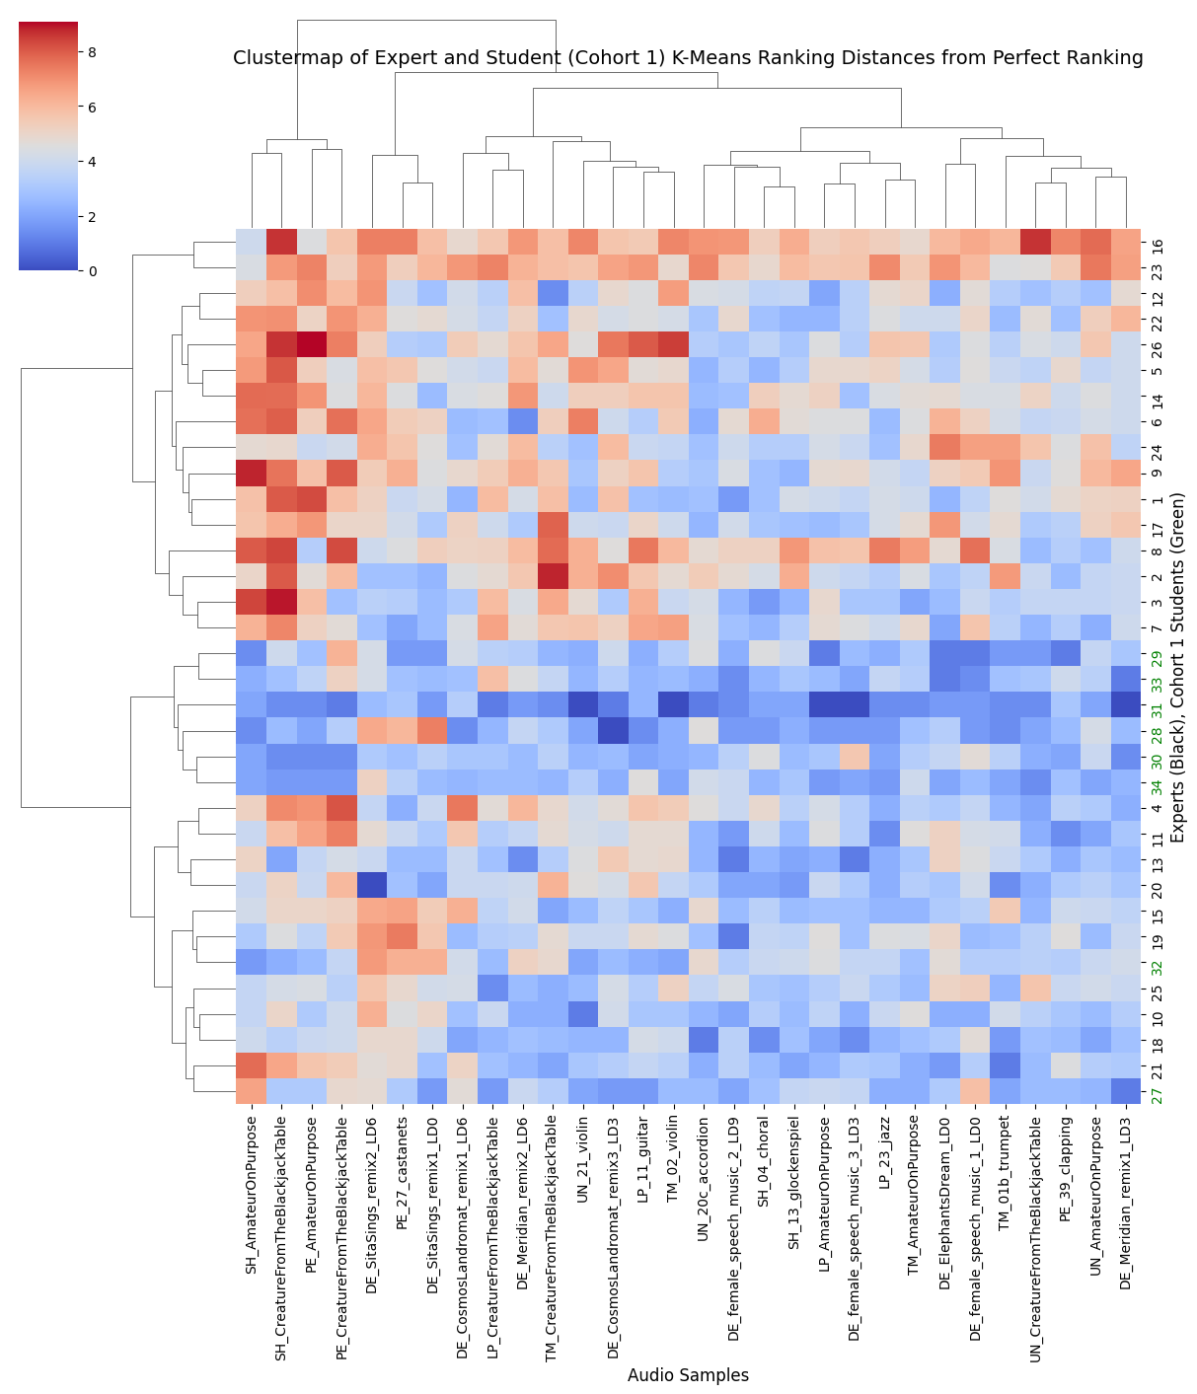
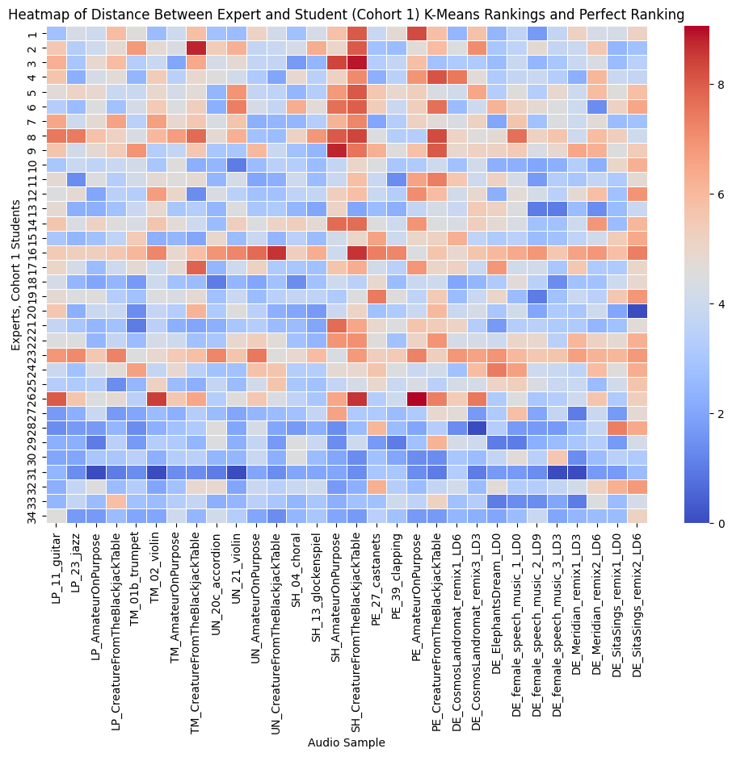
Visualizing Groups (K-Means Ranking): Experts, Cohort 1 Students & Audio Samples

Slide 27
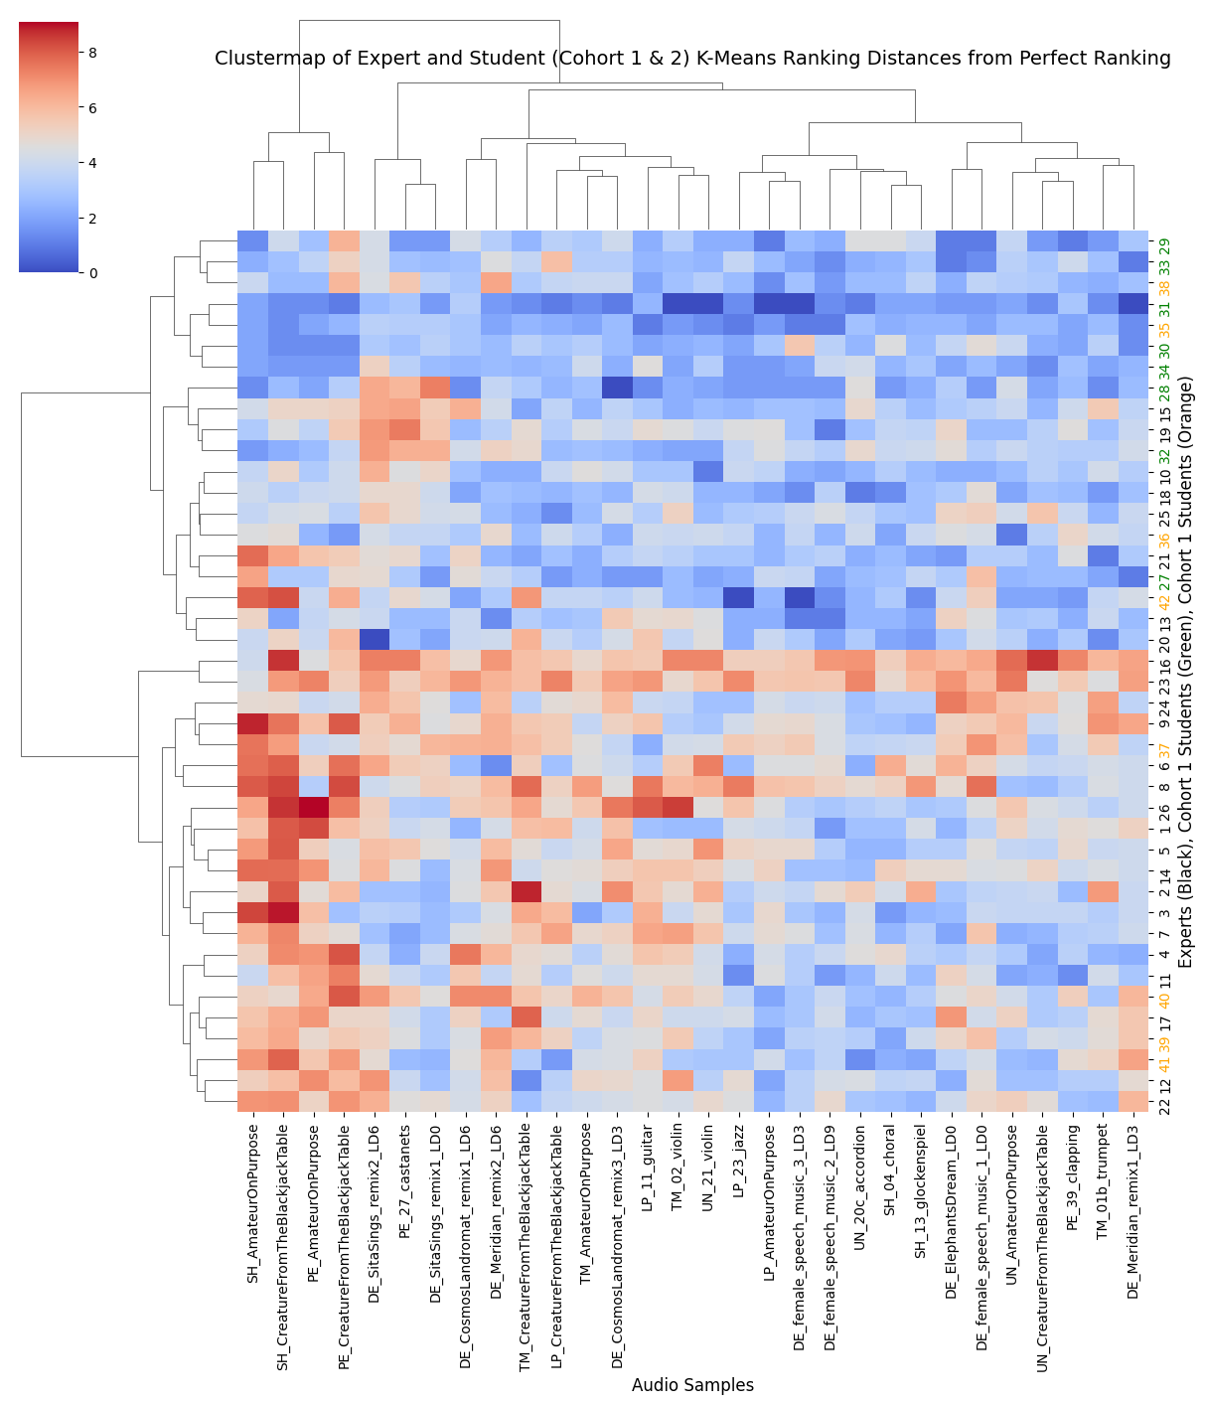
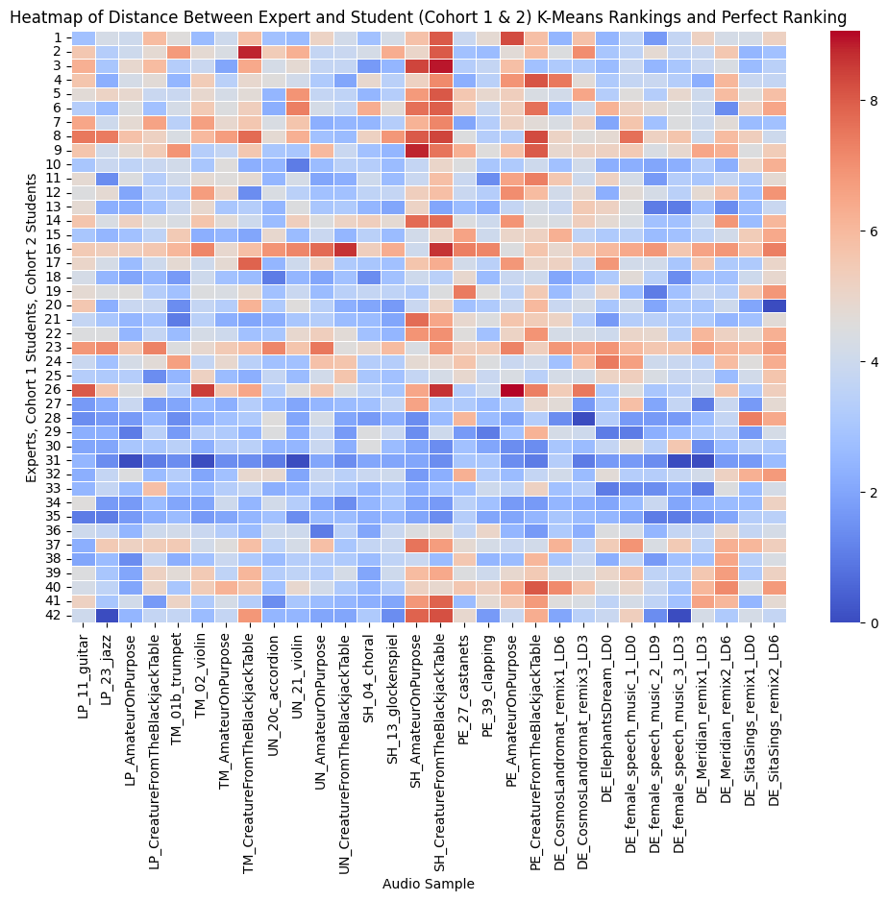
Visualizing Groups (K-Means Ranking): Experts, Cohort 1 Students, Cohort 2 Students & Audio Samples

Slide 28
Contingency Tables
Extracting groups identified through competition and k-means ranking.

Slide 29
Experts Contingency Table from Two Ranking Schemes
K-Means Competition | 1 (Good) | 2 (Worst) | 3 (worse)
1 (Bad) | 1 | 2 | 14
2 (Median) | 9 | 0 | 5
3 (Best) | 10 | 0 | 1

Slide 30
Experts Contingency Table from Two Ranking Schemes
K-Means Competition | 1 (Good) | 2 (Worst) | 3 (worse)
1 (Bad) | #42 | #16, #23 | #1, #4, #5, #7, #8, #9, #12, #17, #22, #26, #37, #39, #40, #41
2 (Median) | #13, #15, #18, #19, #20, #21, #25, #27, #36 |  | #3, #6, #11, #14, #24
3 (Best) | #10, #28, #29, #30, #31, #32, #33, #34, #35, #38 |  | #2

Slide 31
Experts Contingency Table from Two Ranking Schemes
K-Means Competition | 1 (Good) | 2 (Worst) | 3 (worse)
1 (Bad) | #42 | #16, #23 | #1, #4, #5, #7, #8, #9, #12, #17, #22, #26, #37, #39, #40, #41
2 (Median) | #13, #15, #18, #19, #20, #21, #25, #27, #36 |  | #3, #6, #11, #14, #24
3 (Best) | #10, #28, #29, #30, #31, #32, #33, #34, #35, #38 |  | #2

Slide 32
Audio Samples Contingency Table from Two Ranking Schemes
K-Means Competition | 1 (Hardest) | 2 (Hard) | 3 (Medium) | 5 (Easy) | 4 (Easiest)
1 (Easiest) | 1 | 0 | 2 | 2 | 0
2 (Easy)) | 1 | 0 | 3 | 2 | 3
5 (Medium) | 0 | 1 | 2 | 2 | 1
4 (Hard) | 2 | 1 | 2 | 0 | 2
5 (Hardest) | 0 | 1 | 0 | 1 | 1

Slide 33
Audio Samples Contingency Table from Two Ranking Schemes
K-Means Competition | 1 (Hardest) | 2 (Hard) | 3 (Medium) | 5 (Easy) | 4 (Easiest)
1 (Easiest) | 'PE_CreatureFromTheBlackjackTable' |  | 'TM_AmateurOnPurpose', 'TM_CreatureFromTheBlackjackTable' | 'TM_01b_trumpet', 'DE_ElephantsDream_LD0'
2 (Easy)) | 'PE_AmateurOnPurpose' |  | 'LP_11_guitar', 'LP_CreatureFromTheBlackjackTable', 'DE_Meridian_remix2_LD6' | 'UN_AmateurOnPurpose', 'UN_CreatureFromTheBlackjackTable' | 'LP_23_jazz', 'LP_AmateurOnPurpose', 'DE_female_speech_music_2_LD9'
5 (Medium) |  | 'DE_SitaSings_remix1_LD0' | 'DE_CosmosLandromat_remix1_LD6', 'DE_CosmosLandromat_remix3_LD3' | 'DE_female_speech_music_1_LD0', 'DE_Meridian_remix1_LD3' | 'DE_female_speech_music_3_LD3']
4 (Hard) | 'SH_AmateurOnPurpose', 'SH_CreatureFromTheBlackjackTable | 'DE_SitaSings_remix2_LD6' | 'TM_02_violin', 'UN_21_violin' |  | 'UN_20c_accordion', 'SH_04_choral'
3 (Hardest) |  | 'PE_27_castanets' |  | 'PE_39_clapping' | 'SH_13_glockenspiel'

Slide 34
Audio Samples Contingency Table from Two Ranking Schemes
K-Means Competition | 1 (Hardest) | 2 (Hard) | 3 (Medium) | 5 (Easy) | 4 (Easiest)
1 (Easiest) | 'PE_CreatureFromTheBlackjackTable' |  | 'TM_AmateurOnPurpose', 'TM_CreatureFromTheBlackjackTable' | 'TM_01b_trumpet', 'DE_ElephantsDream_LD0'
2 (Easy) | 'PE_AmateurOnPurpose' |  | 'LP_11_guitar', 'LP_CreatureFromTheBlackjackTable', 'DE_Meridian_remix2_LD6' | 'UN_AmateurOnPurpose', 'UN_CreatureFromTheBlackjackTable' | 'LP_23_jazz', 'LP_AmateurOnPurpose', 'DE_female_speech_music_2_LD9'
5 (Medium) |  | 'DE_SitaSings_remix1_LD0' | 'DE_CosmosLandromat_remix1_LD6', 'DE_CosmosLandromat_remix3_LD3' | 'DE_female_speech_music_1_LD0', 'DE_Meridian_remix1_LD3' | 'DE_female_speech_music_3_LD3']
4 (Hard) | 'SH_AmateurOnPurpose', 'SH_CreatureFromTheBlackjackTable | 'DE_SitaSings_remix2_LD6' | 'TM_02_violin', 'UN_21_violin' |  | 'UN_20c_accordion', 'SH_04_choral'
3 (Hardest) |  | 'PE_27_castanets' |  | 'PE_39_clapping' | 'SH_13_glockenspiel'

Slide 35
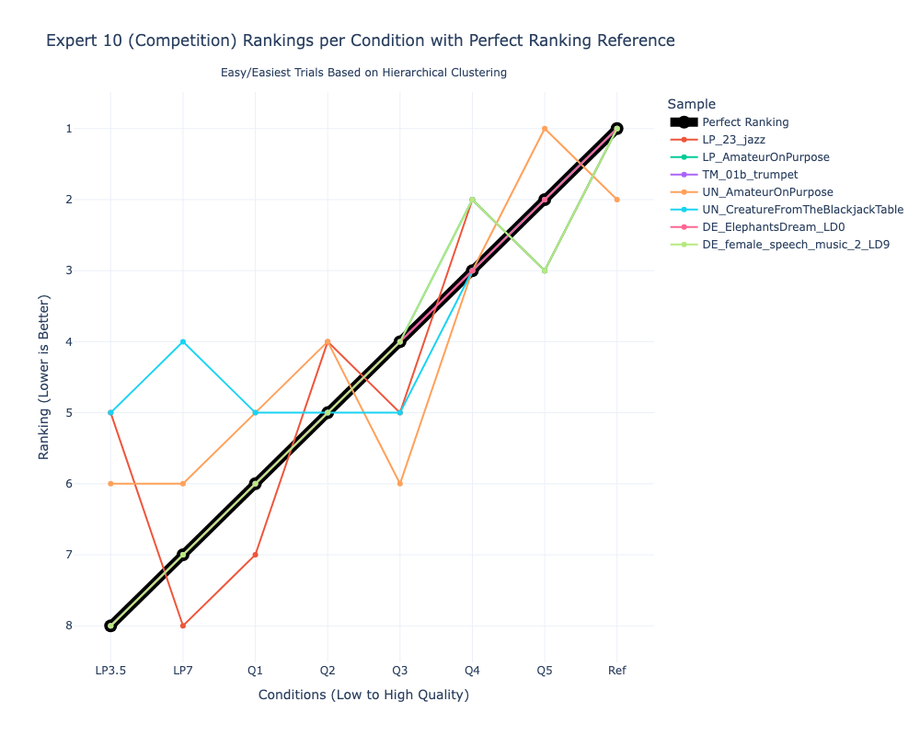
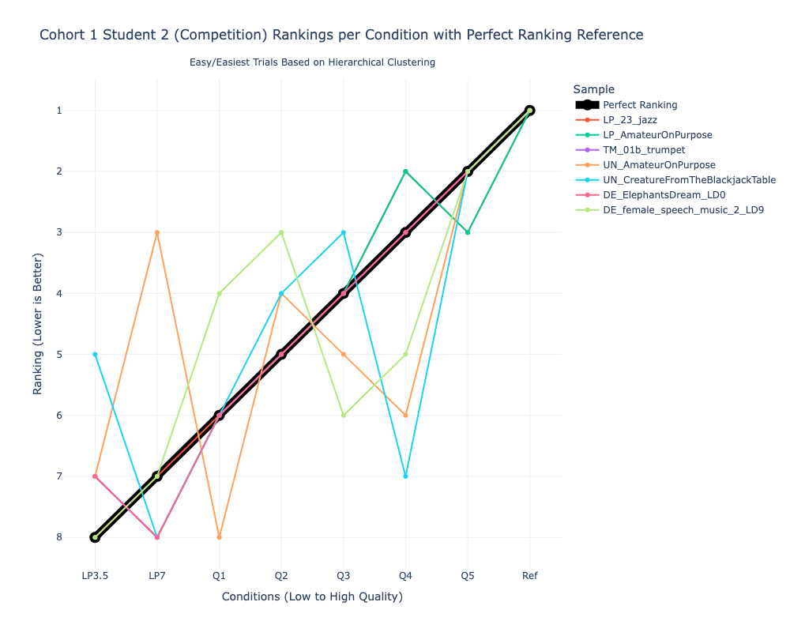
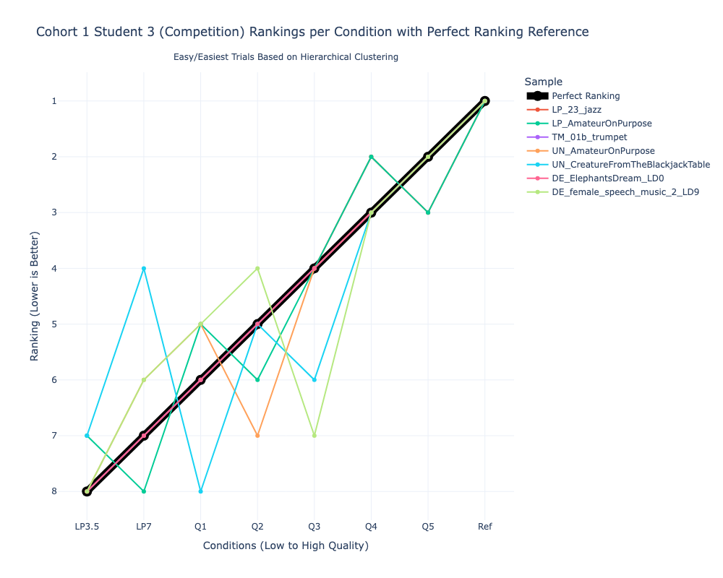
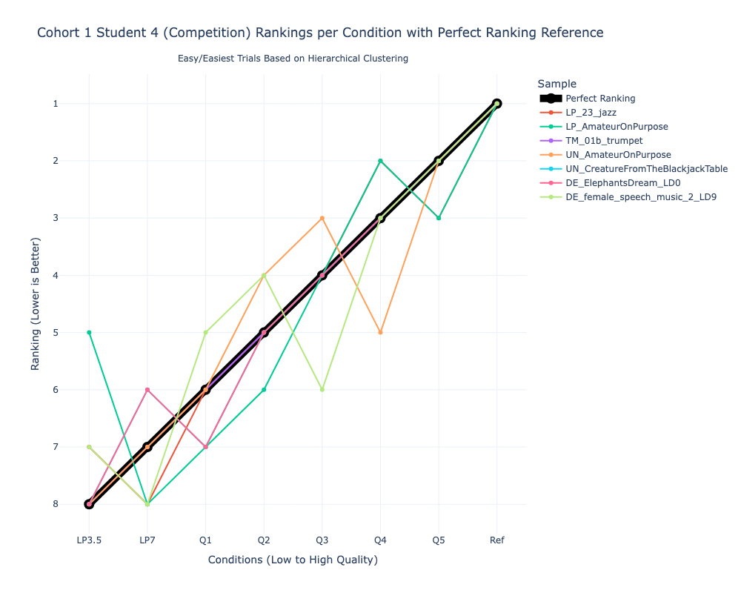
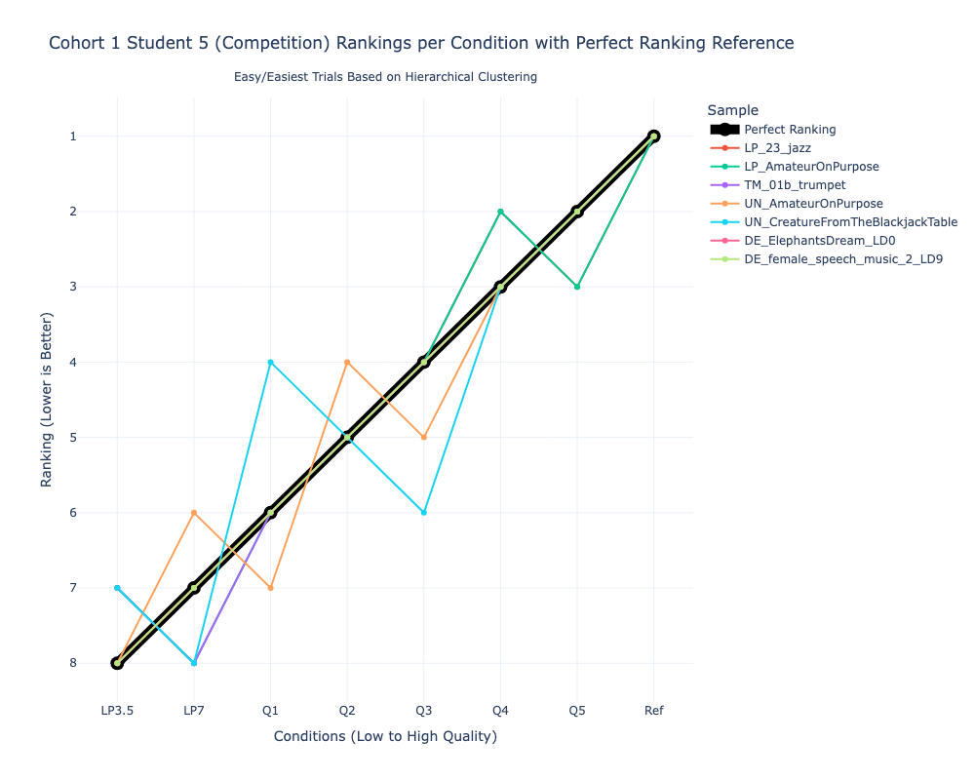
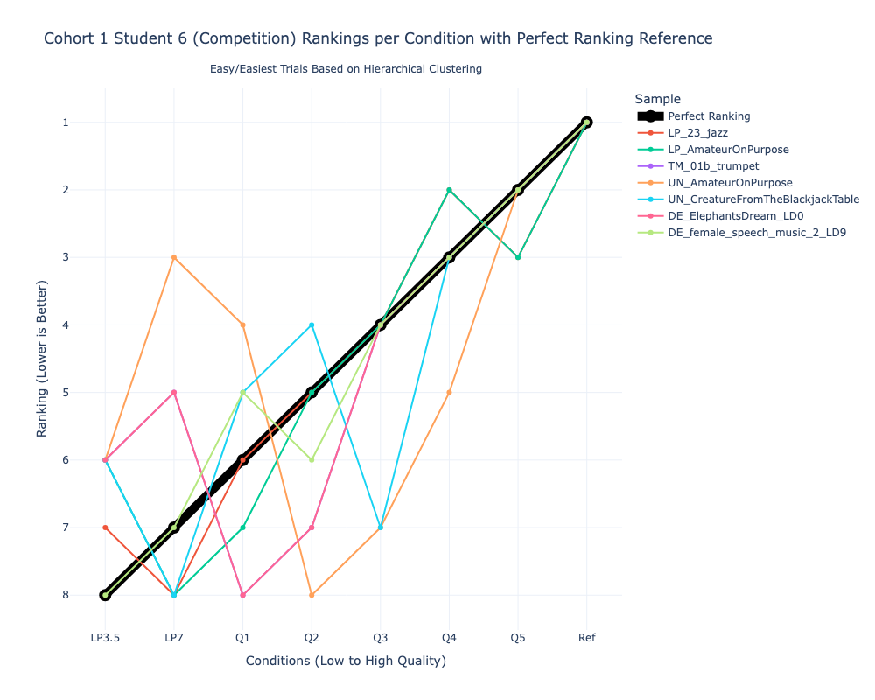
Competition Ranking: Best & Good Experts on Easy & Easiest Audio Samples

Slide 36
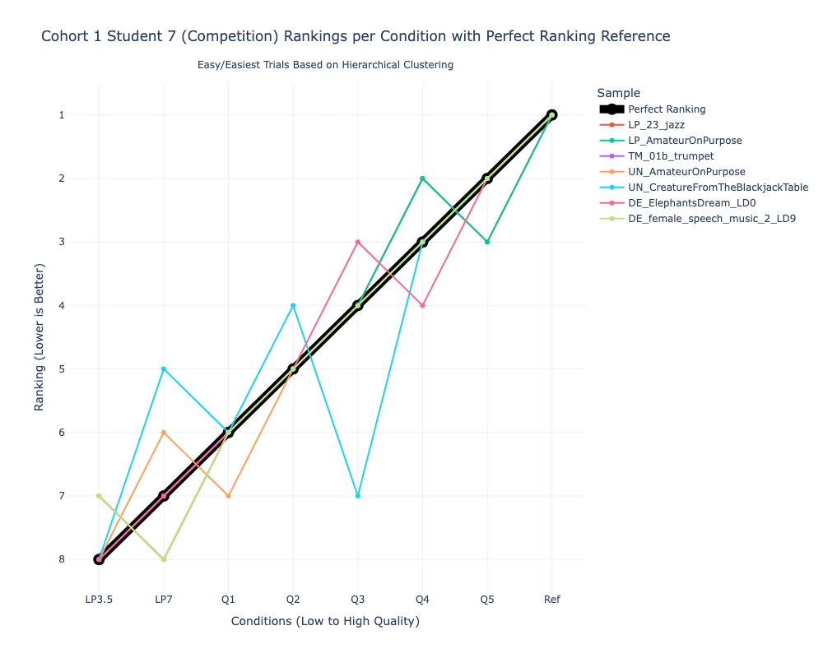
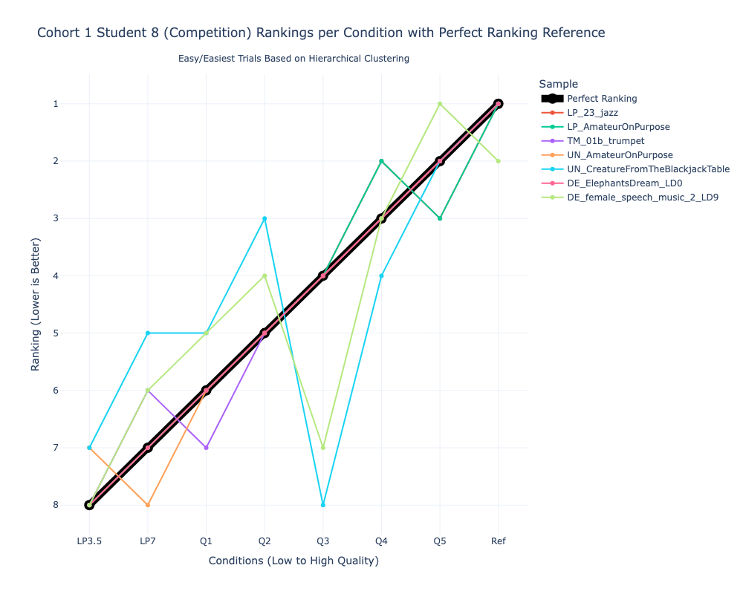
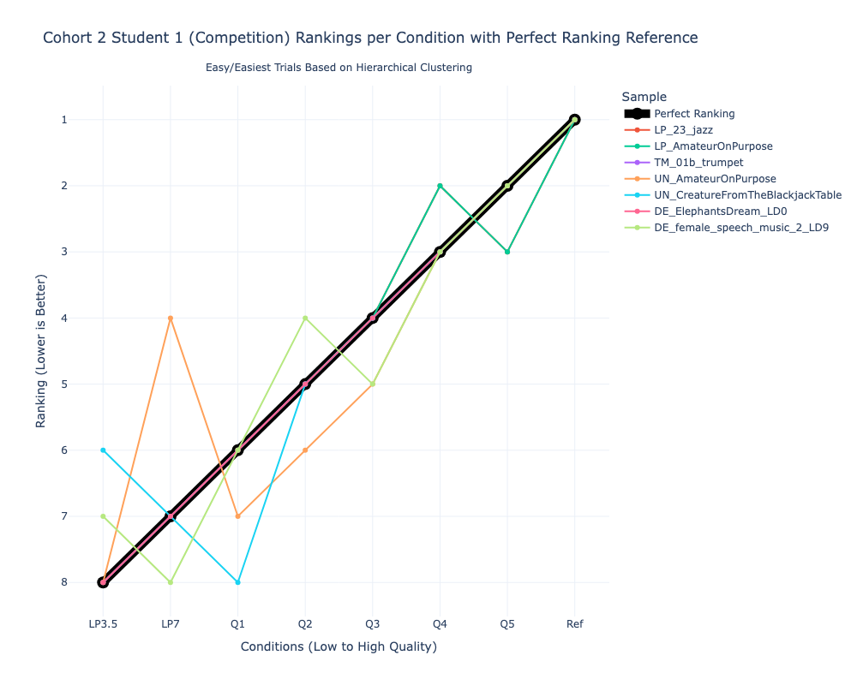

Competition Ranking: Best & Good Experts on Easy & Easiest Audio Samples

Slide 37






K-Means Ranking: Best & Good Experts on Easy & Easiest Audio Samples

Slide 38




K-Means Ranking: Best & Good Experts on Easy & Easiest Audio Samples

